Slide 1





Let's Start
Student Performance Analysis Based on JAMB Scores

Slide 2





Topik Permasalahan
Faktor-faktor yang Mempengaruhi Skor JAMB pada Siswa di Tahun 2024
Kaggle
Siswa di Nigeria
Client : Guru/Staff Pengajar

Slide 3




Latar Belakang
1
What
2
Who
3
When
4
Where
5
Why
6
How

Slide 4
Analysis
Data Loading
Data Cleaning
Descriptive Analysis
17 columns, 5000 rows
missing value
central tendency
Inferencial Analysis
Dashboard
chi-square & ANOVA
tableau

Slide 5
Column
JAMB_Score | Study_Hours_Per_Week | Attendance_Rate | Teacher_Quality | Distance_To_School | School_Type | School_Location | Extra_Tutorials | Access_To_Learning_Materials
Parent_Involvement | IT_Knowledge | Student_ID | Age | Gender | Socioeconomic_Status | Parent_Education_Level | Assignments_Completed

Slide 6
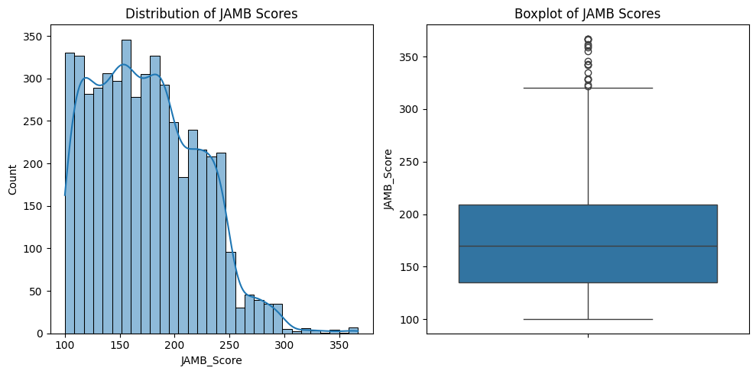
Descriptive Analysis
Median
M
Mean
Median JAMB Score: 170.0
Mean JAMB Score: 174.0746
M
M
Modus
Modus JAMB Score: 118

Slide 7

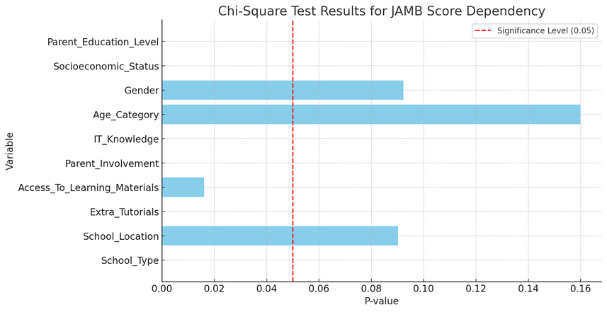
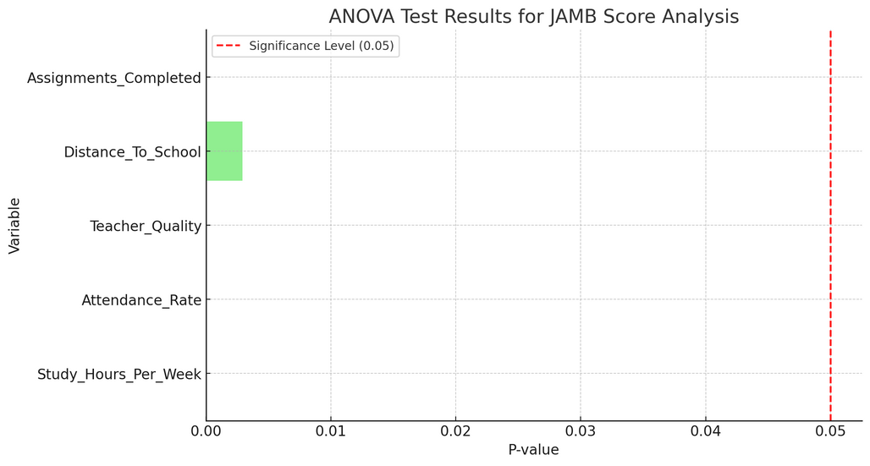

Variable | P-value | Dependence
School_Type | 0 | Dependent
School_Location | 0.09015 | Independent
Extra_Tutorials | 1.00E-05 | Dependent
Access_To_Learning_Materials | 0.01607 | Dependent
Parent_Involvement | 0 | Dependent
IT_Knowledge | 0 | Dependent
Age_Category | 0.15989 | Independent
Gender | 0.09226 | Independent
Socioeconomic_Status | 0 | Dependent
Parent_Education_Level | 0 | Dependent
Inferential Analysis
Variable | F-statistic | P-value | Significant
Study_Hours_Per_Week | 27.90858078 | 6.95E-186 | Yes
Attendance_Rate | 9.666643341 | 2.46E-68 | Yes
Teacher_Quality | 123.9437269 | 5.16E-101 | Yes
Distance_To_School | 1.306101738 | 0.002909259 | Yes
Assignments_Completed | 108.9238876 | 3.93E-89 | Yes
ANOVA
Chi-square

Slide 8
DASHBOARD
&
Kesimpulan

Slide 9
End
Thank you

